Slide 1
Spring Boot Dev Tools

Slide 2

Enabling Dev Tools Module Property defaults
Overview
Automatic Restarts
Live Reload
Global settings
Remote applications

Slide 3
Add Spring-Boot-Devtools in a Project

Slide 4

Dependencies
<dependency>
<groupId>org.springframework.boot</groupId>
<artifactId>spring-boot-devtools</artifactId>
</dependency>

Slide 5
Property Defaults

Slide 6
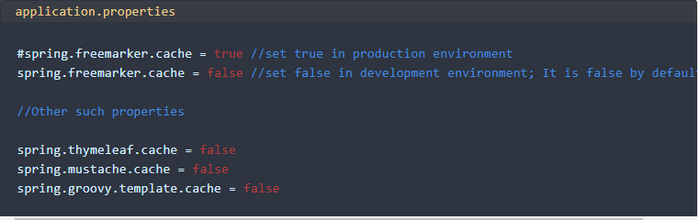
Property Defaults

Slide 7
Auto Restart

Slide 8
Auto Restart

Slide 9
Live Reload

Slide 10

Live Reload

Slide 11
Global Settings

Slide 12

Global Settings File

Slide 13
Remote Applications

Slide 14
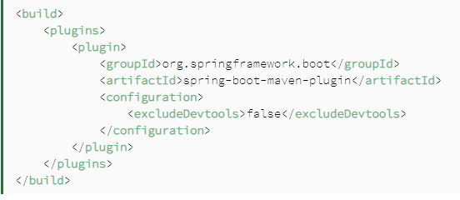
Remote Applications

Slide 15
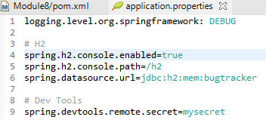
Remote Applications

Slide 16
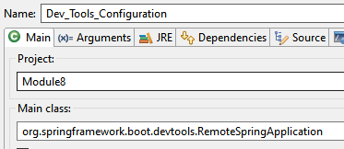
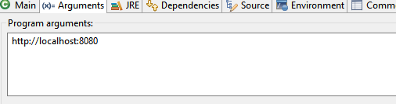
Running the remote client application

Slide 17
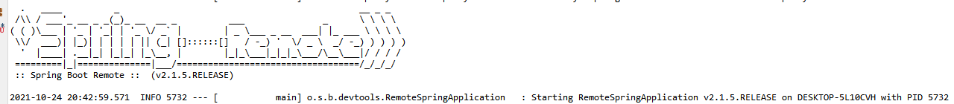
Running the remote client application

Slide 18
Leverage the spring-boot-devtools module to make the developer experience better and reduce the development time by automating a lot of activities.
Summary

